Slide 1


Computer Networks
Week1_Lecture2 (Chapter1)
Course organization and introduction
Subhan Ullah, PhD
subhan.ullah@nu.edu.pk
BS(Computer Science) Spring-2024

Slide 2
Agenda
Computer Networks Applications
a day in the life of a web request
Careers in Computer Networking
Chapter1 Overview/roadmap:
What is the Internet?
What is a protocol?
Network edge
Network core

Slide 3
Applications are the consumers of networks
On a simple click, several messages may be exchanged over the Internet
In a web browser, around 17 messages may be exchanged for a single request
up to six messages to translate the server name (DNS queries)
three messages to set up a connection (TCP connection)
four messages to send HTTP “get” request + response
four messages to close the TCP connection
See this link for a reference: (Home task)
https://aws.amazon.com/blogs/mobile/what-happens-when-you-type-a-url-into-your-browser/
Notes:
Domain name system (DNS)

Slide 4
Motivation: a day in the life of a web request
NOTE: Slides from 5 to 12 are just for the motivation on this stage
Throughout the course your goal will be to understand all the nuts and bolts of this Synthesis (from slide 5-12)
At the end of the course you should understand the components involved in the following scenario (Synthesis)

Slide 5
Synthesis: a day in the life of a web request
Millions of messages are exchanged each day by Internet nodes to make their presence and services known
application, transport, network, link
Brief overview of a single web request (synthesis)
goal: identify, review, understand protocols (at all layers) involved in seemingly simple scenario: requesting www page
scenario: student attaches laptop to campus network, requests/receives www.google.com

Slide 6




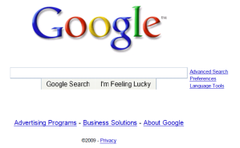
A day in the life: scenario
scenario:
DNS server
arriving mobile client attaches to network …
browser
Comcast network
68.80.0.0/13
requests web page: www.google.com
school network
68.80.2.0/24
web page
Sounds
simple!
web server
Google’s network
64.233.160.0/19
64.233.169.105

Slide 7
A day in the life: connecting to the Internet
DHCP
DHCP
UDP
IP
Eth
Phy
connecting laptop needs to get its own IP address, addr of first-hop router, addr of DNS server: use DHCP
DHCP
DHCP
DHCP
arriving mobile:
DHCP client
DHCP
DHCP request encapsulated in UDP, encapsulated in IP, encapsulated in 802.3 Ethernet
DHCP
DHCP
UDP
IP
Eth
Phy
DHCP
DHCP
DHCP
DHCP
Ethernet frame broadcast (dest: FFFFFFFFFFFF) on LAN, received at router running DHCP server
router has
DHCP server
Ethernet demuxed to IP demuxed, UDP demuxed to DHCP

Slide 8

A day in the life: connecting to the Internet
DHCP
UDP
IP
Eth
Phy
DHCP server formulates DHCP ACK containing client’s IP address, IP address of first-hop router for client, name & IP address of DNS server
DHCP
DHCP
DHCP
arriving mobile:
DHCP client
DHCP
encapsulation at DHCP server, frame forwarded (switch learning) through LAN, demultiplexing at client
DHCP
DHCP
UDP
IP
Eth
Phy
DHCP
DHCP
DHCP
DHCP
router has
DHCP server
DHCP client receives DHCP ACK reply
Client now has IP address, knows name & addr of DNS
server, IP address of its first-hop router

Slide 9
A day in the life… ARP (before DNS, before HTTP)
DNS
DNS
UDP
IP
Eth
Phy
before sending HTTP request, need IP address of www.google.com: DNS
DNS
DNS
ARP
ARP query
arriving mobile:
ARP client
DNS query created, encapsulated in UDP, encapsulated in IP, encapsulated in Eth. To send frame to router, need MAC address of router interface: ARP
ARP
ARP query broadcast, received by router, which replies with ARP reply giving MAC address of router interface
ARP reply
Eth
Phy
router has
ARP server
client now knows MAC address of first hop router, so can now send frame containing DNS query

Slide 10
A day in the life… using DNS
DNS
DNS
DNS
DNS
DNS
DNS
UDP
IP
Eth
Phy
demuxed to DNS
DNS replies to client with IP address of www.google.com
DNS
DNS
UDP
IP
Eth
Phy
DNS
DNS
DNS
DNS
DNS
DNS
server
DNS
DNS
Comcast network
68.80.0.0/13
IP datagram containing DNS query forwarded via LAN switch from client to 1st hop router
IP datagram forwarded from campus network into Comcast network, routed (tables created by RIP, OSPF, IS-IS and/or BGP routing protocols) to DNS server

Slide 11
A day in the life…TCP connection carrying HTTP
DNS
DNS
DNS
HTTP
HTTP
TCP
IP
Eth
Phy
to send HTTP request, client first opens TCP socket to web server
SYNACK
SYN
SYNACK
SYN
SYNACK
SYN
SYN
Comcast network
68.80.0.0/13
TCP SYN segment (step 1 in TCP 3-way handshake) inter-domain routed to web server
TCP
IP
Eth
Phy
web server responds with TCP SYNACK (step 2 in TCP 3-way handshake)
SYNACK
SYN
SYNACK
SYN
SYNACK
SYNACK
SYN
TCP connection established!
Google web server
64.233.169.105

Slide 12
A day in the life… HTTP request/reply
DNS
DNS
DNS
HTTP
HTTP
TCP
IP
Eth
Phy
HTTP request sent into TCP socket
HTTP
HTTP
HTTP
web page finally (!!!) displayed
HTTP
HTTP
HTTP
HTTP
HTTP
IP datagram containing HTTP request routed to www.google.com
Comcast network
68.80.0.0/13
web server responds with HTTP reply (containing web page)
HTTP
HTTP
TCP
IP
Eth
Phy
HTTP
HTTP
HTTP
HTTP
IP datagram containing HTTP reply routed back to client
Google web server
64.233.169.105

Slide 13
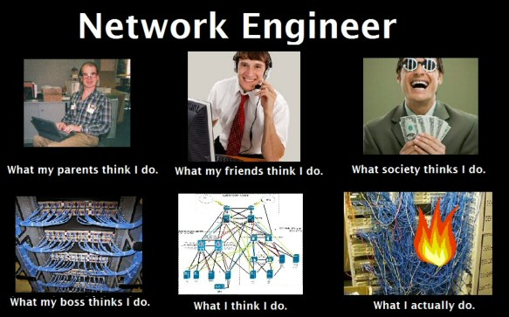
Careers in Computer Networking
Network Administrator
Network Manager
Network Engineer/Architect
Network Programmer/Analyst
Network Service Technician
Instructor of Computer Networks
And many more…
https://www.worldwidelearn.com/guide-to/technology/computer-networking-major/
Notes:
Network administrators are responsible for keeping a network up and running–like an auto mechanic for the network.
A network engineer designs and manages the groups of computers networked together.
Network analysts support the computer network and the overall computer infrastructure.
Information systems administrators assist with the design, delivery, and maintenance of an information technology infrastructure within the organization.
https://www.hierarchystructure.com/networking-job-hierarchy/
https://www.herzing.edu/degree/computer-networking
https://www.worldwidelearn.com/guide-to/technology/computer-networking-major/

Slide 14

Chapter 1: introduction
Chapter goal:
Get “feel,” “big picture,” introduction to terminologies
more depth, detail later in course
Overview/roadmap:
What is the Internet? What is a protocol?
Network edge: hosts, access network, physical media
Network core: packet/circuit switching, internet structure
Performance: loss, delay, throughput
Protocol layers, service models
Security
History (home work)

Slide 15













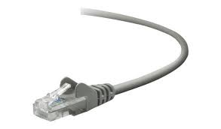
The Internet: a “nuts and bolts” view
Billions of connected computing devices:
hosts = end systems
running network apps at Internet’s “edge”
mobile network
national or global ISP
Packet switches: forward packets (chunks of data)
routers, switches
local or regional ISP
Internet
Communication links
fiber, copper, radio, satellite
transmission rate: bandwidth
home network
content
provider
network
datacenter
network
Networks
collection of devices, routers, links: managed by an organization
enterprise
network
https://www.internetworldstats.com/stats.htm
Notes:
World wide population is 7.9 Billion, where 4.95 billion people around the world use the internet in January 2022 – equivalent to 62.5 percent of the world’s total population.
5 billion devices connected to the Internet in 2015.
25 billion in 2020 was estimated
Over 3.2 billion Internet users worldwide in 2015 and approximately 40% of the world wide population.

Slide 16






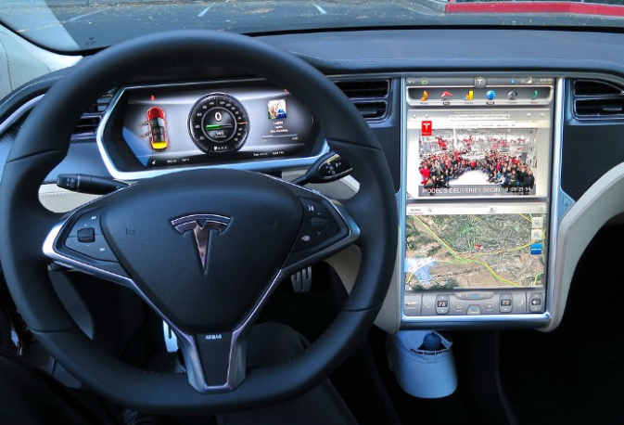





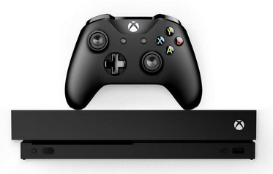



“Fun” Internet-connected devices
Tweet-a-watt:
monitor energy use
bikes
Pacemaker & Monitor
Amazon Echo
Web-enabled toaster +
weather forecaster
IP picture frame
Internet
refrigerator
Slingbox: remote
control cable TV
cars
Security Camera
AR devices
sensorized,
bed
mattress
scooters
Others?
Gaming devices
Internet phones
Fitbit

Slide 17
The Internet: a “nuts and bolts” view
mobile network
4G
Internet: “network of networks”
Interconnected ISPs
national or global ISP
protocols are everywhere
control sending, receiving of messages
e.g., HTTP (Web), streaming video, Skype, TCP, IP, WiFi, 4G, Ethernet
IP
Streaming
video
Skype
local or regional ISP
home network
content
provider
network
Internet standards
RFC: Request for Comments
IETF: Internet Engineering Task Force
HTTP
datacenter
network
Ethernet
TCP
enterprise
network
WiFi
Home work: ISPs in Pakistan: https://isp.today/en/list-of-all-services/PAKISTAN
RFC detail link: https://www.rfc-editor.org/search/rfc_search.php IETF: https://www.ietf.org/about/who/
Notes:
https://www.stackoftuts.com/internet-marketing/list-of-internet-service-providers-isp-in-pakistan/
PTCL, Stormfiber, Nayatel, Wi-tribe, Fiberlink, Worldcall, Wateen telecom, Qubee, COMSATS Internet Service
Who invented the Internet?
The Internet grew out of ARPANET, a US-military funded academic research project (in 1970s).
The internet is a global network comprising many voluntarily interconnected autonomous networks. It operates without a central governing body. The technical underpinning and the standardization of the core protocols is the activity of the Internet Engineering Task Force(IETF) a non profit organization of loosely affiliated international participants that anyone may associate with by contributing technical expertise. To maintain interoperability the principal name spaces of the internet administered by the Internet Corporation for Assigned Names and Numbers (ICANN) which is governed by an international board of directors drawn from across the internet technical ,business, academic, and other non commercial communities.
ICANN coordinates the work of unique identifiers for use on the internet, including domain names, internet protocol(IP) addresses , application port numbers etc.
This role of ICANN distinguishes it as perhaps the only central coordinating body for the global internet.
ICANN:
Assigns IP addresses and assigns DNS top-level domains
Operates 13 root DNS servers.
IETF:
Develops protocols that define how Internet devices interact.
RFCs are documents defining Internet standards.

Slide 18
The Internet: a “services” view
Infrastructure that provides services to applications:
Web, streaming video, multimedia teleconferencing, email, games, e-commerce, social media, inter-connected appliances, …
mobile network
national or global ISP
Streaming
video
Skype
local or regional ISP
provides programming interface to distributed applications:
“hooks” allowing sending/receiving apps to “connect” to, use Internet transport service
provides service options, analogous to postal service
home network
content
provider
network
HTTP
datacenter
network
enterprise
network
Notes:
https://pakwired.com/famous-internet-service-providers-pakistan-review/
https://www.stackoftuts.com/internet-marketing/list-of-internet-service-providers-isp-in-pakistan/
ISPs in Pakistan: https://isp.today/en/list-of-all-services/PAKISTAN
PTCL, Stormfiber, Nayatel, Wi-tribe, Fiberlink, Worldcall, Wateen telecom, Qubee, COMSATS Internet Service

Slide 19
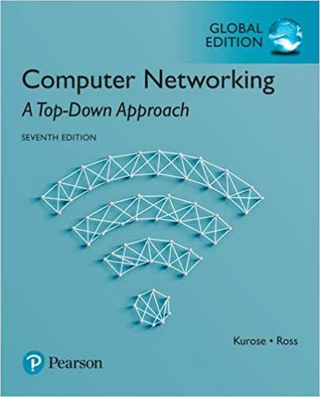
Thank You All
☺
?
A note on the origin of these ppt slides:
All material copyright 1996-2020 J.F Kurose and K.W. Ross, All Rights Reserved
These slides are freely provided by the book authors and it represents a lot of work on their part. We would like to thank J.F Kurose and K.W. Ross.

